Slide 1
SNPeffect
Qian & Colton & Xu
Professors:
Joost Schymkowitz
Mark Fiers
Rob van der Kant

Slide 2
Our work during this session
1) Collect Mutant PDB files from our cancer data set
Pipeline from VCF to Sequence to PDB
Intersect VCF files with Human Genome-19 -> Mutated Genome
Mutated Genome x Human Annotation GTF -> Mutated PDB
2) Collect data from Tools discussed in Session 1
Use assumed result from step1 to collect FoldX, Pfam, Tango and
IUPred information
3) Use this data to fill in tables in our database Change from MongoDB to MySQL

Slide 3
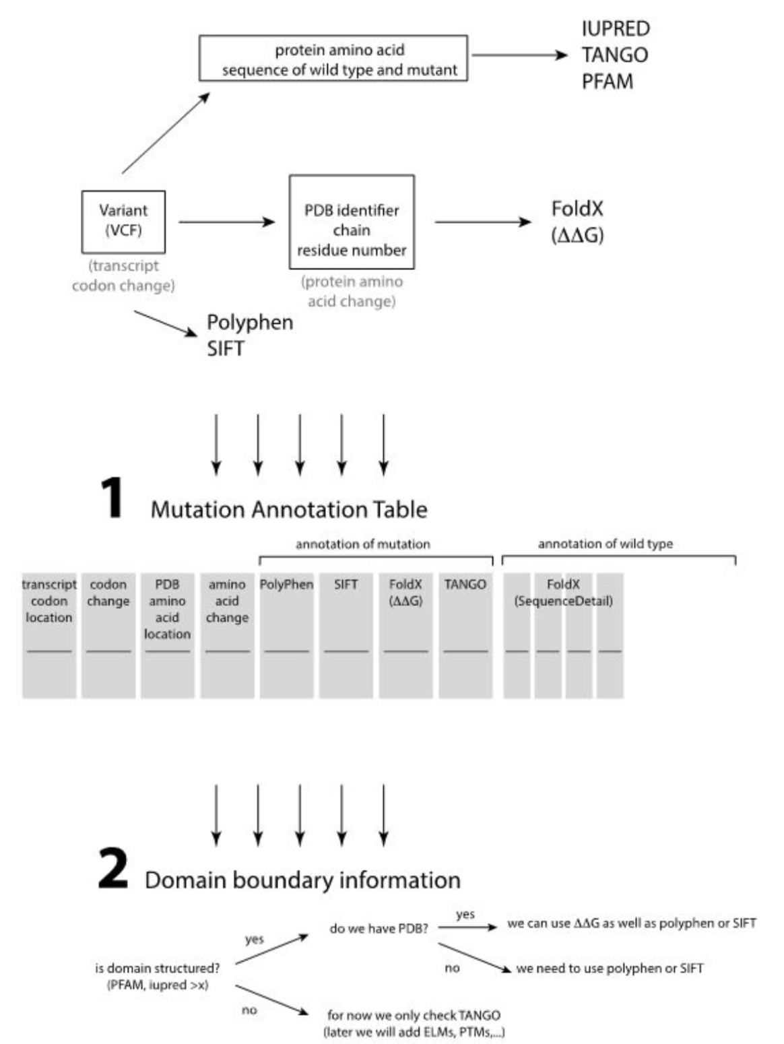
Reminder

Slide 4
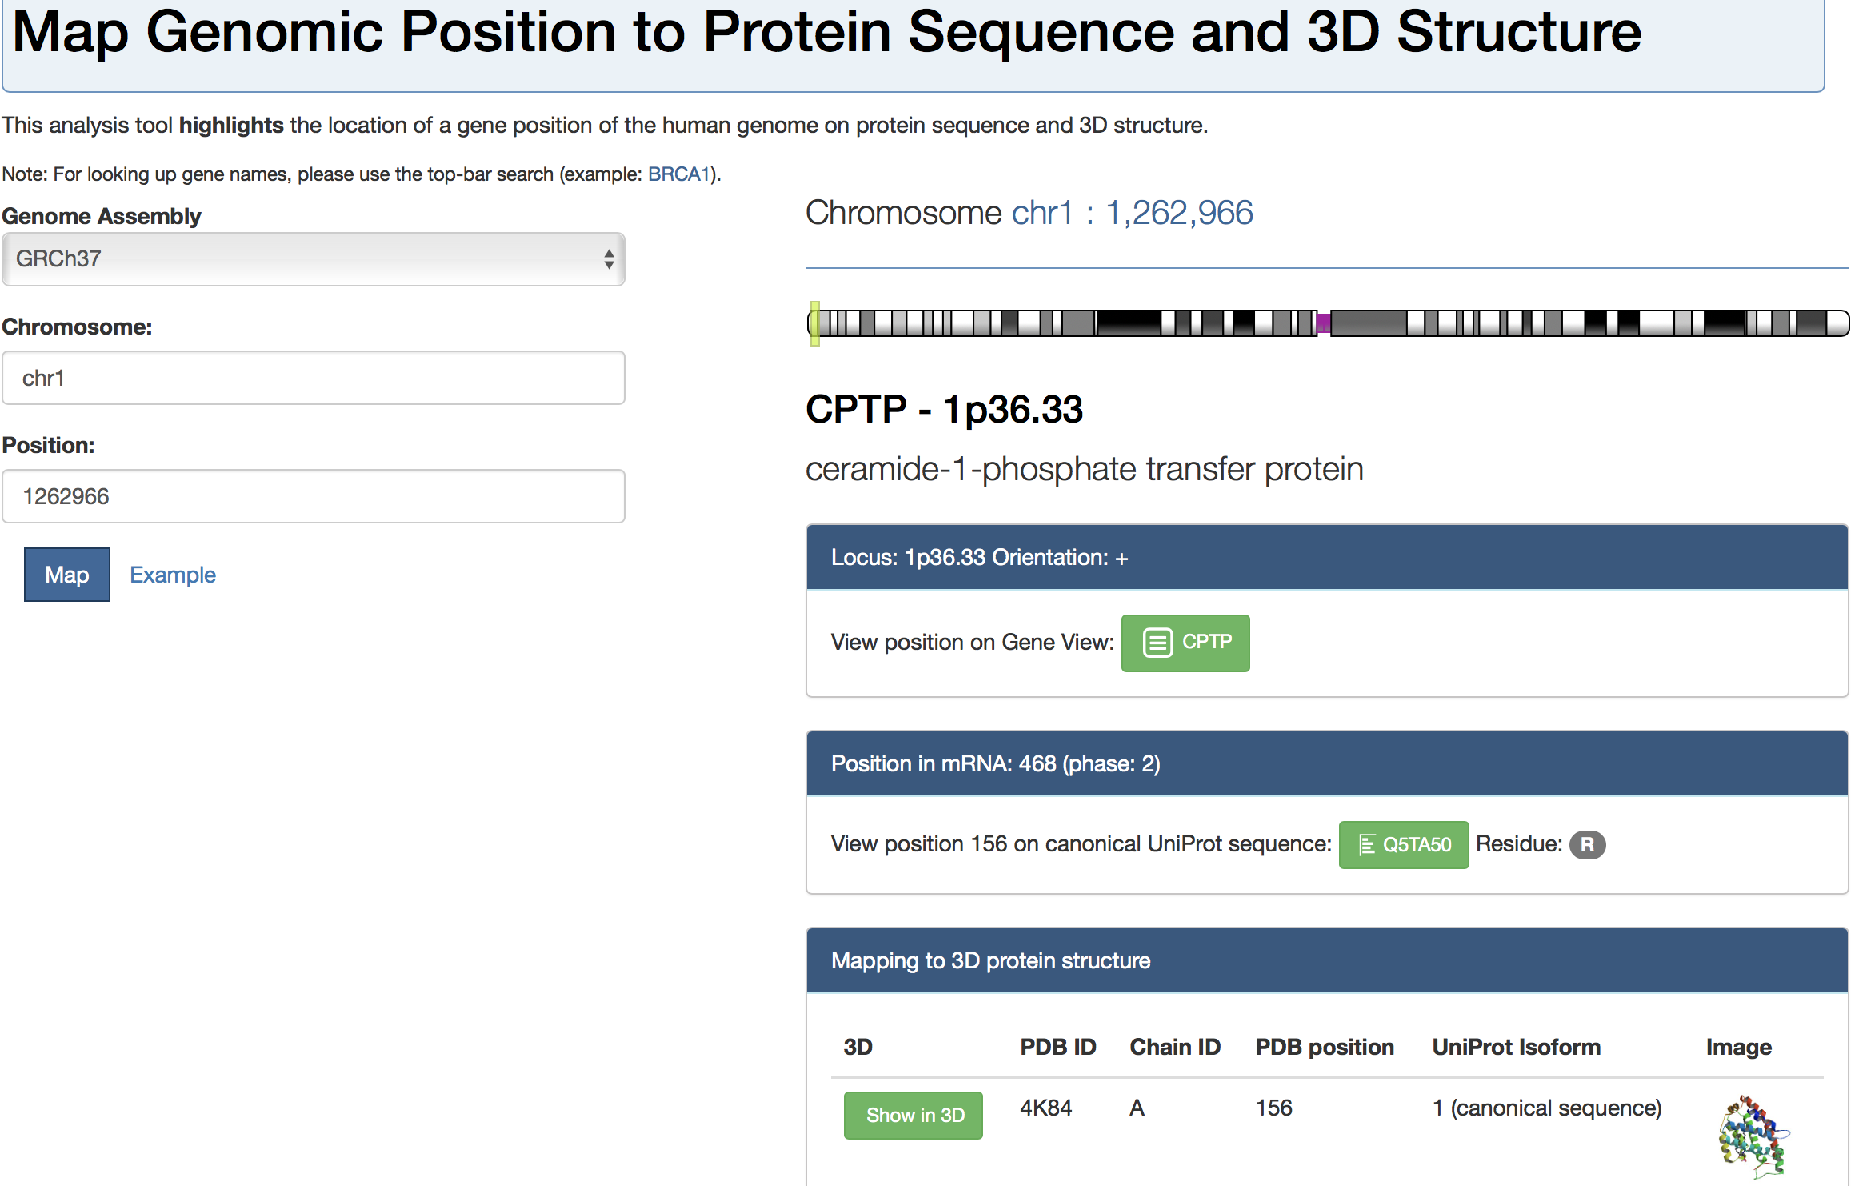
Our goal
more than this

Slide 5
Challenges
What codon?
which AA to which AA -> Genomic position
where?
residue position
Complicated relationships -> One to multiple, multiple to multiple
SNPs to gene
gene to transcripts
uniprot to pdb
uniprot to transcripts (isoforms)

Slide 6
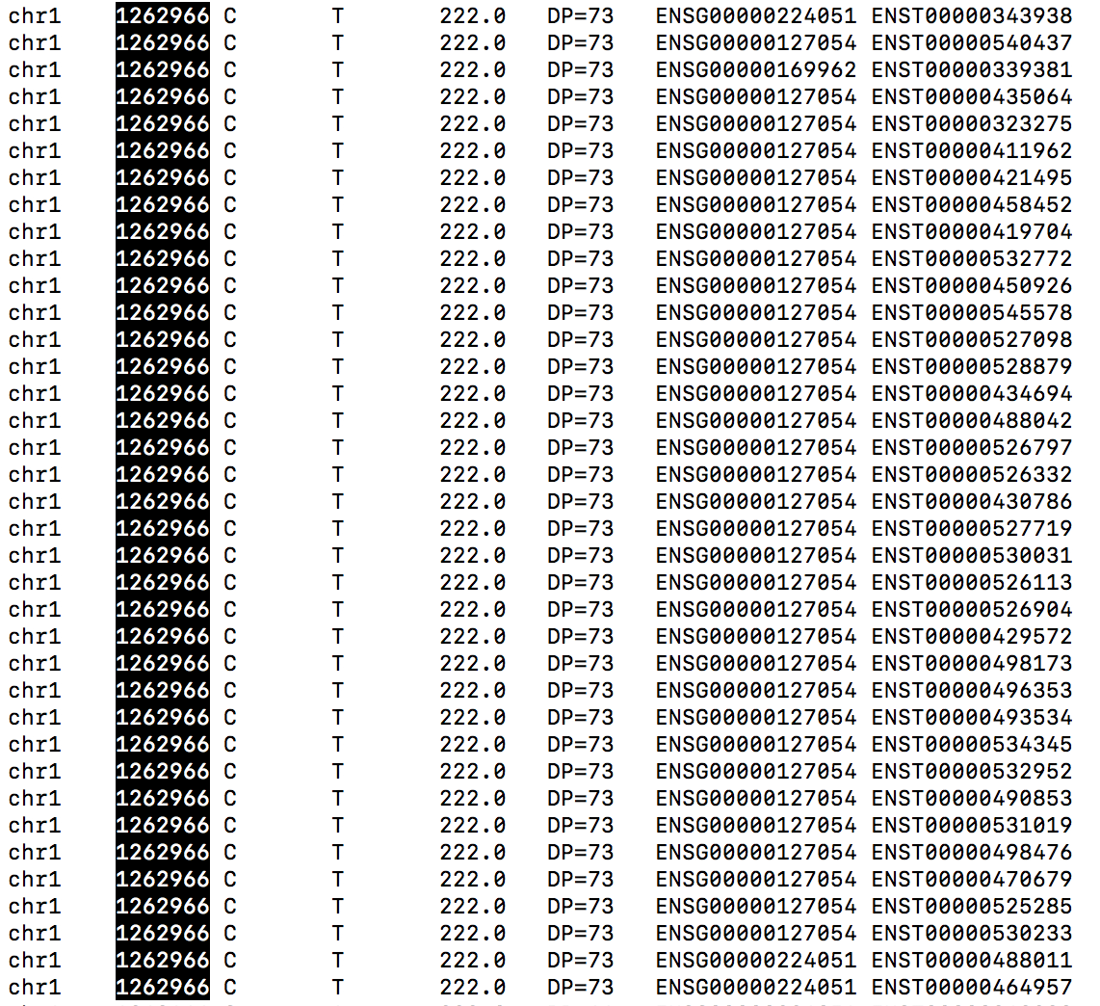
SNPeff annotation
.vcf
geneIDs and transcriptIDs
71798 snps in vcf
1611 snps as toy dataset
12880 genes and transcripts combination

Slide 7
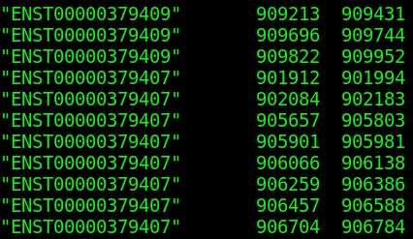
Human Genome Annotation File
.gtf
location on genome
Mapping the SNP’s to the transcripts of Coding Sequence
Part of Coordinate Table - location
of nucleotides and corresponding
RNA sequences

Slide 8
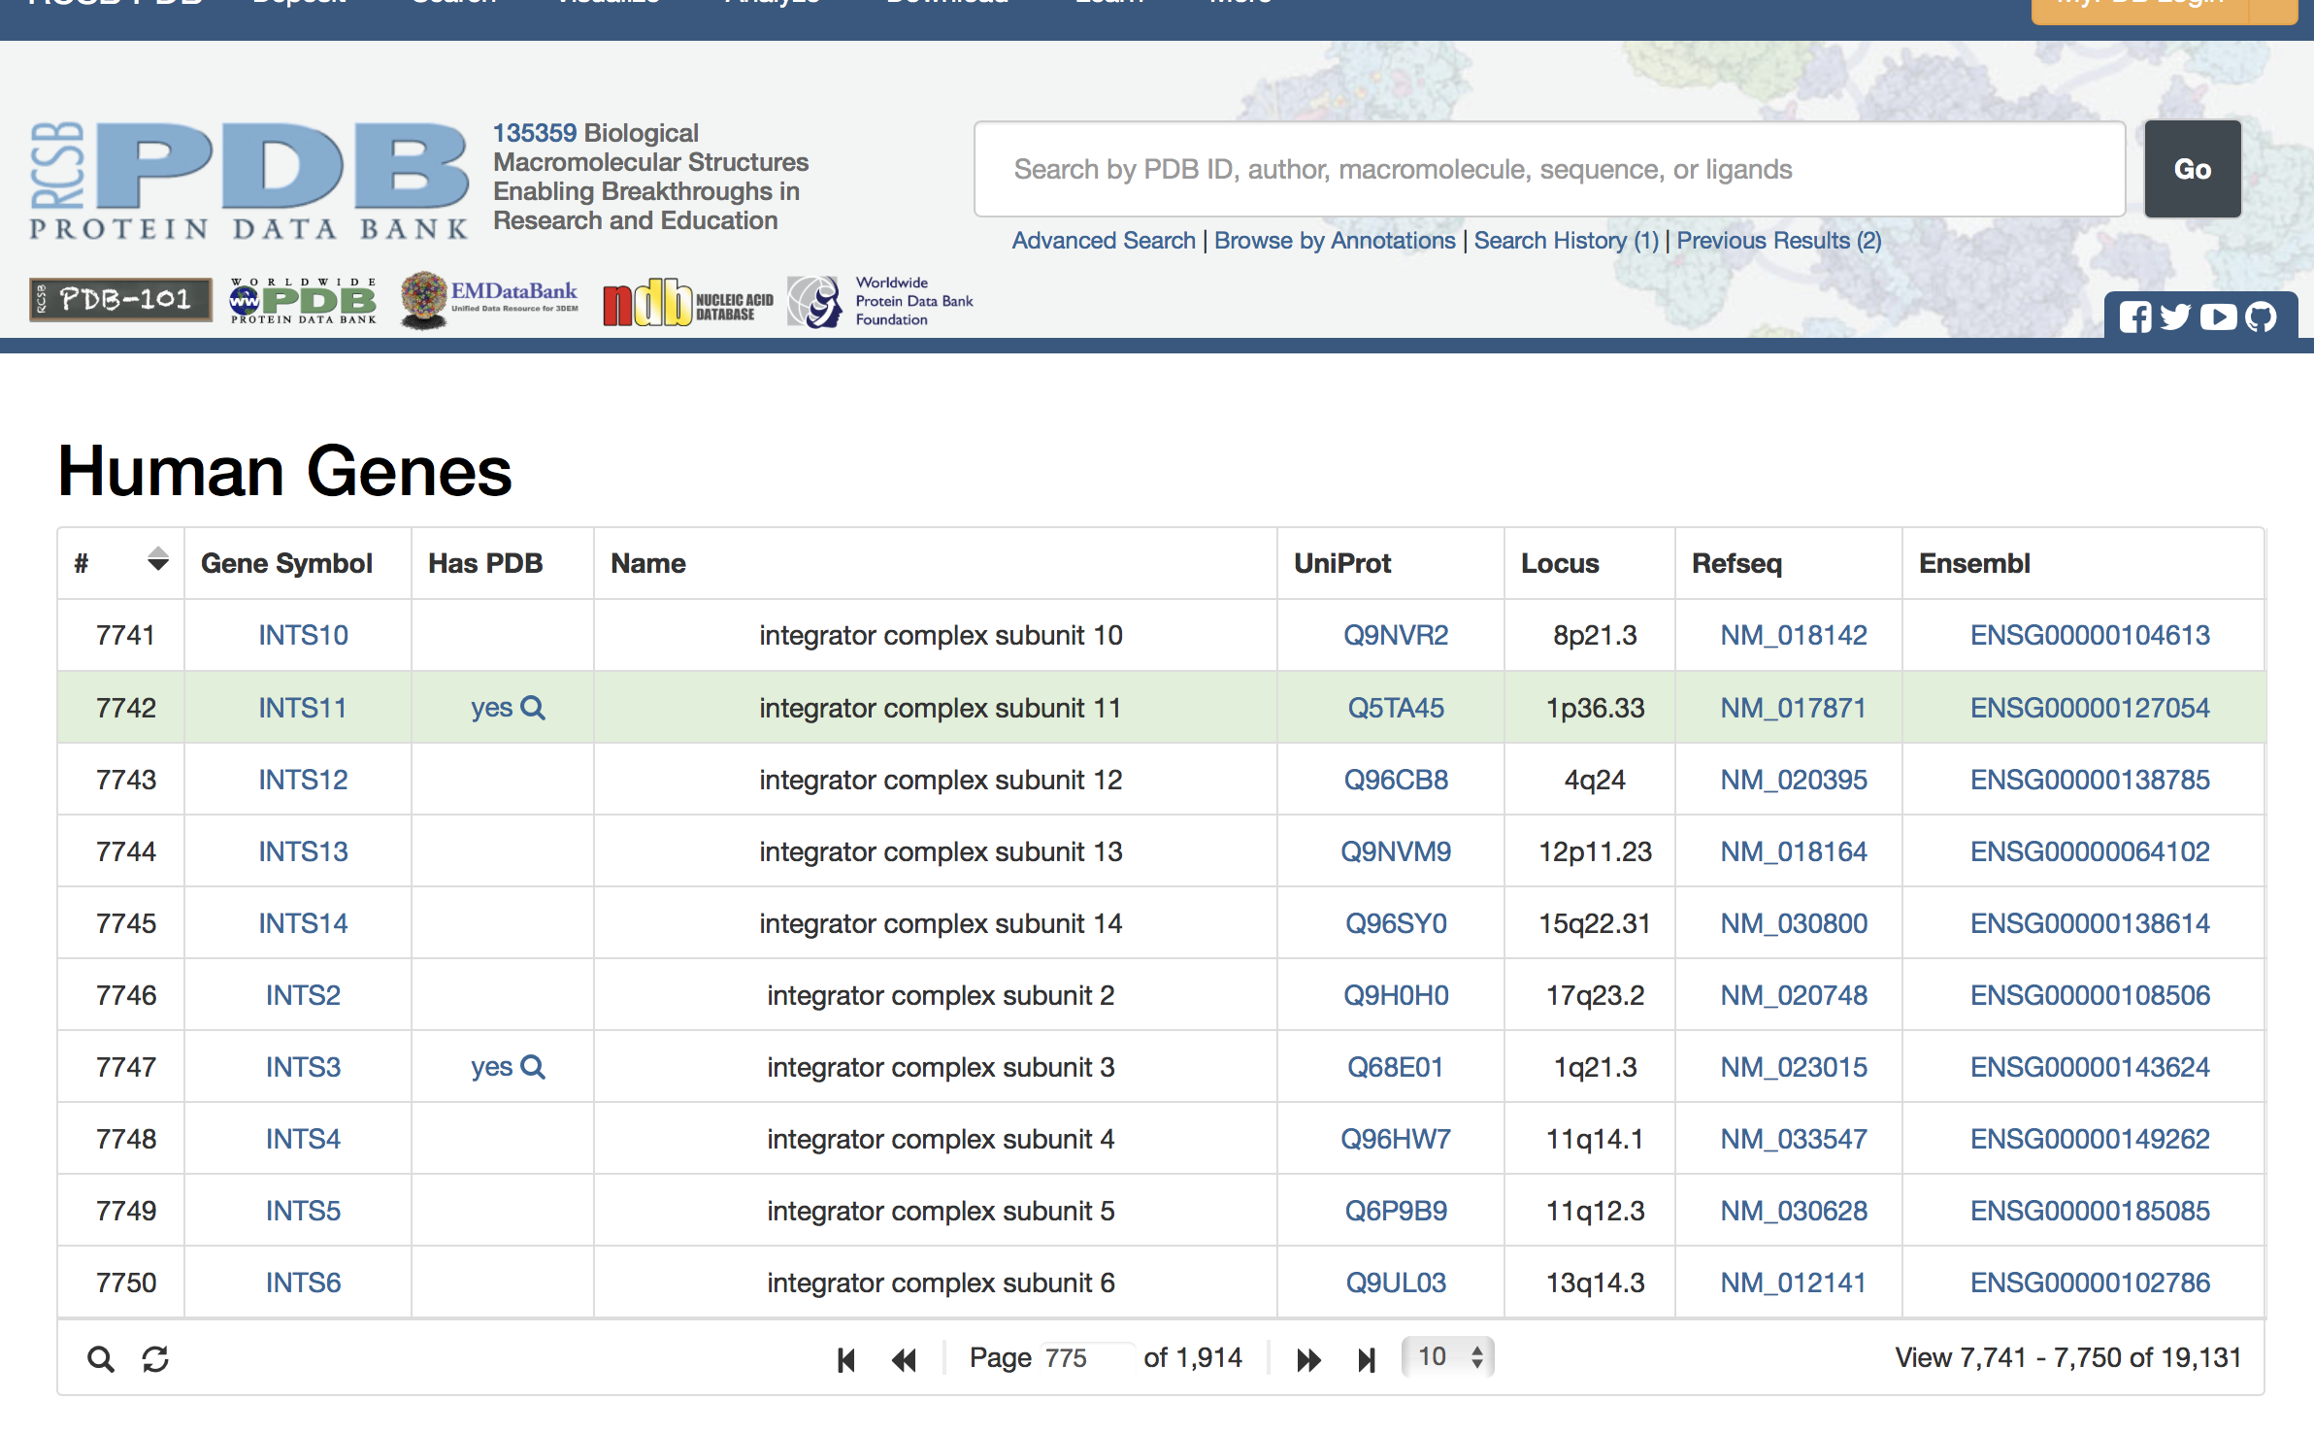
Gene to UniProt
geneID
UniProtID
not one to one relationship
19131 records
10739 (12880)
JSON file
MongoDB
retrieve using Query

Slide 9
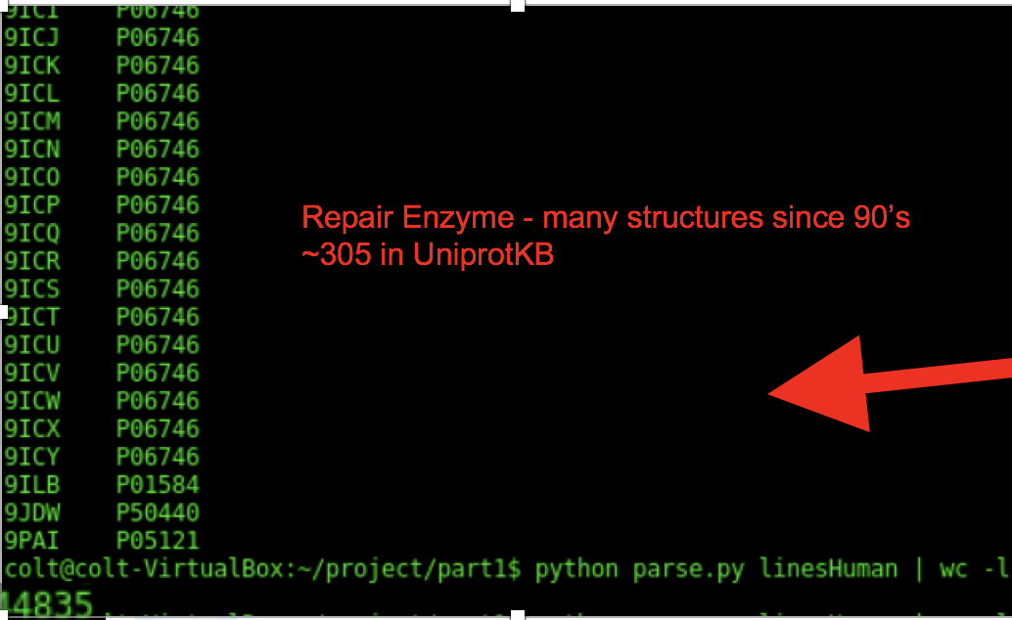
UniProt to PDB
multiple to multiple
4629 (12880) have PDBs
UniProtID
PDB

Slide 10
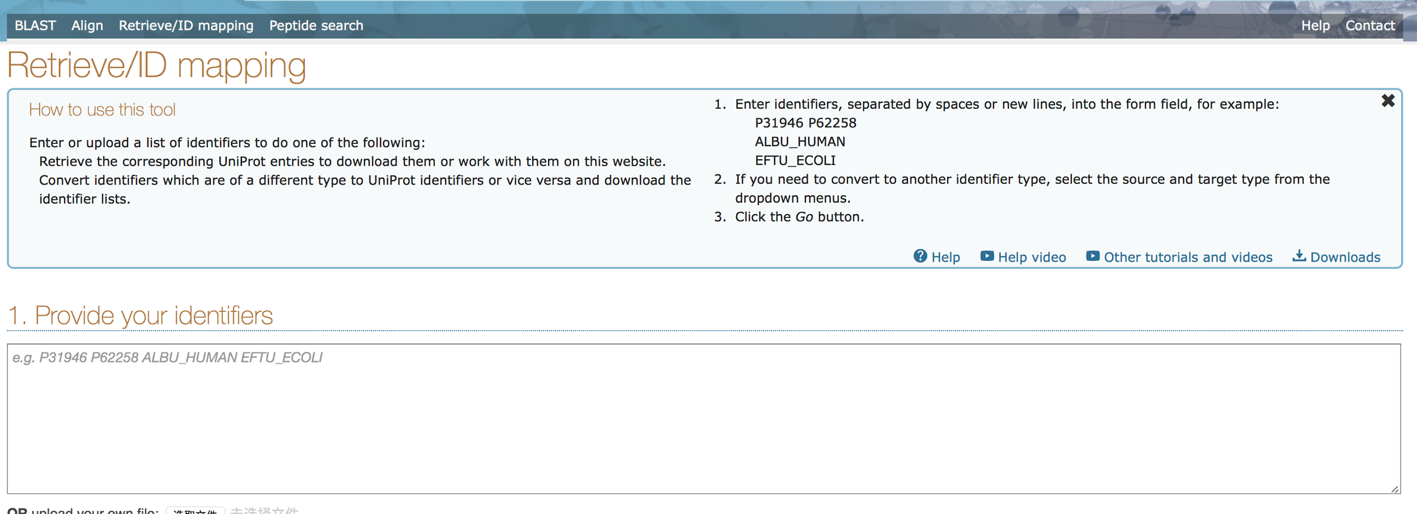
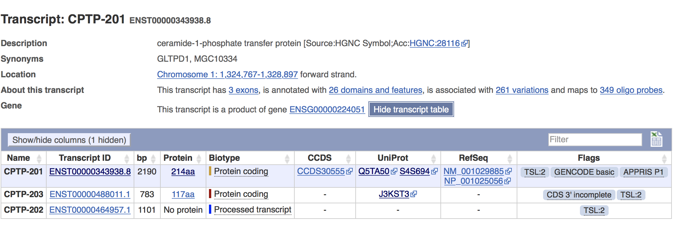
UniProt to transcripts (isoform)
UniProtID
Transcripts

Slide 11
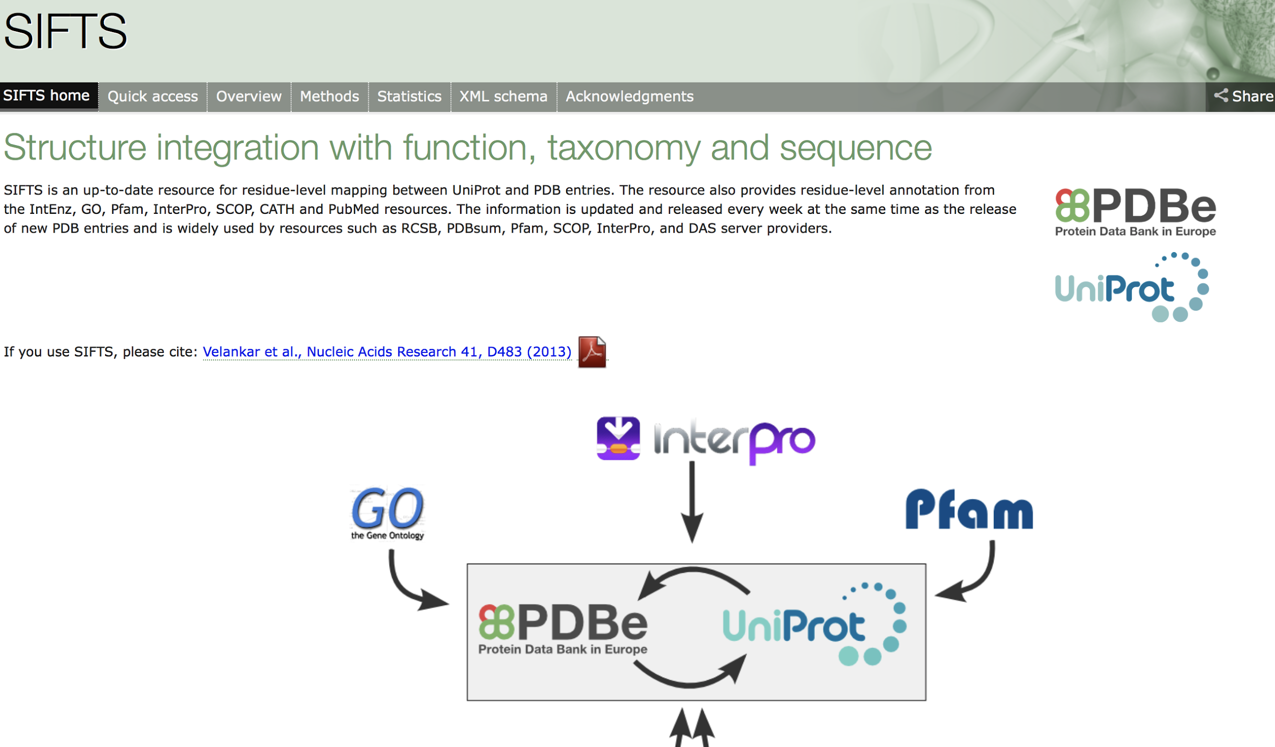
Mapping - SIFTs
UniProt
PDB
Notes:
The two teams have developed a semi-automated process for maintaining up-to-date cross-reference information to UniProt entries, for all protein chains in the PDB entries present in the UniProt database. This process is carried out for every weekly PDB release and the information is stored in the SIFTS database. The SIFTS process includes cross-references to other biological resources such as Pfam, SCOP, CATH, GO, InterPro and the NCBI taxonomy database

Slide 12
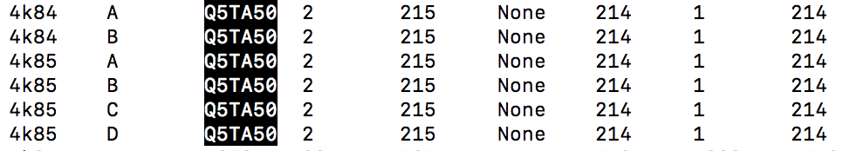
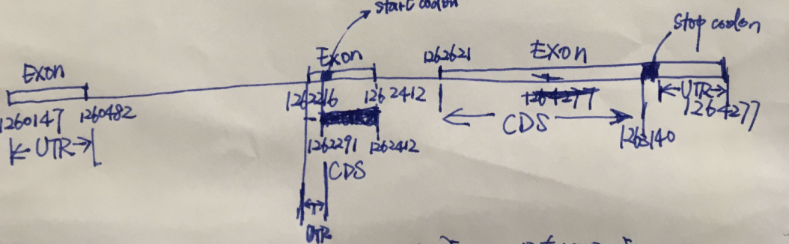
Location
.gtf
location on genome

Slide 13
Summary
.vcf
geneIDs and transcriptIDs
UniProtID
.gtf
location on genome
PDB
which residue on PDB mutate to which AA

Slide 14
Reminder

Slide 15
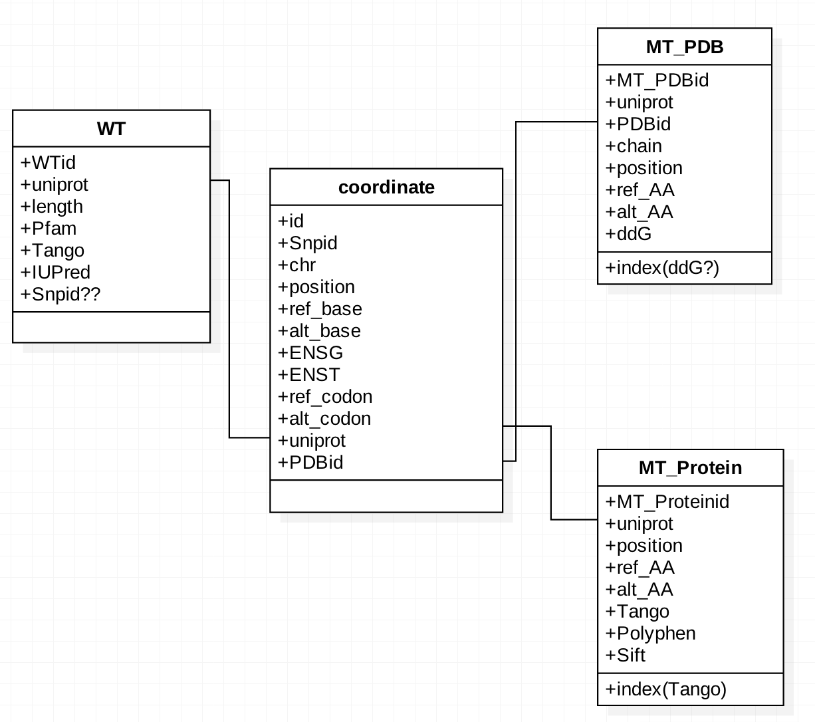
MySQL
4 Levels:
gene
transcript
protein
PDB

Slide 16
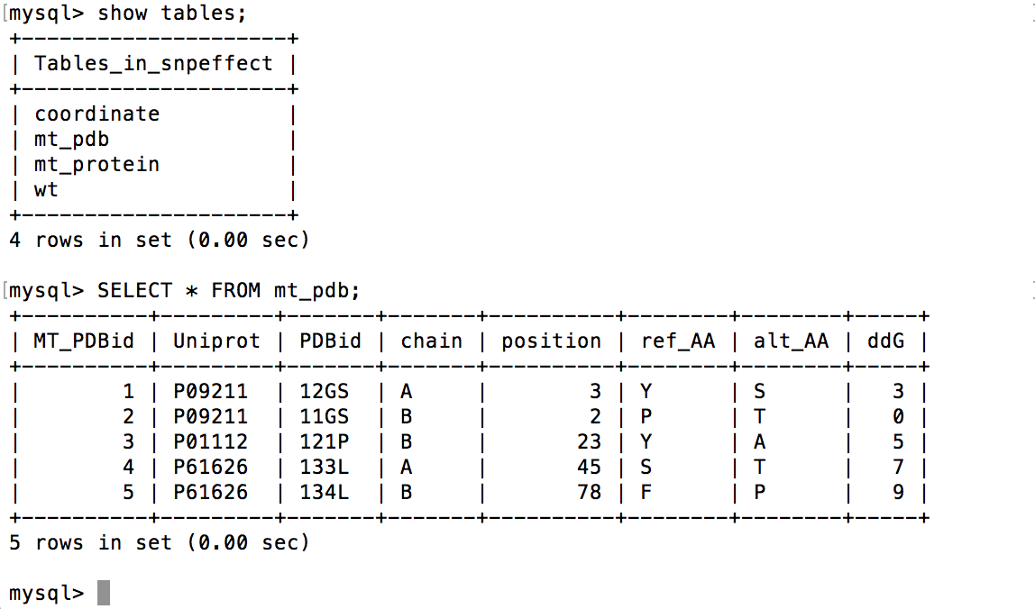

Slide 17
Potential query example
- (A) Find all mutations that have DDG > x in domain with TANGO > y SELECT Snpid
FROM COORDINATE as C WHERE C.Uniprot =
SELECT Uniprot FROM MT_PROTEIN as M
WHERE (M.Tango > y)
AND C.PDBid =
SELECT PDBid FROM MT_PDB as P
WHERE (P.DDG > x)
- (B) Find all mutations that have DTANGO > x in a domain with iupred > y
- (C) Calculate the total mutation load in a cell, e.g. by summing the expression levels of all mutations in A or B

Slide 18
Next
1) Finish whole pipeline: from .vcf to PDB information
2) Put results in databases(MySQL, MongoDB)
simple comparison
Scripts:
https://github.com/yuq1993/IBP

